Slide 1
CGB1201 – JAVA PROGRAMMING
Department of Artificial Intelligence and Data Science
Academic Year: 2024 – 2025 (Odd Semester)
Register Number :2303811724322088
Name :RENUSRI P
Year :II
Semester :III
Section :B
Date :3.12.24

Slide 2
Title of the Project
SCHOOL MANAGEMENT SYSTEM

Slide 3
Problem Identification
Traditional paper-based records are time-consuming, prone to errors, and difficult to manage.
Difficulty in creating and managing class schedules, especially in large institutions.
Risk of sensitive data, such as student information, being accessed by unauthorized users.
Challenges in monitoring pending fees or generating accurate financial reports.

Slide 4
Objective
The objective of a school management system is to streamline and enhance the administrative, academic, and operational processes of educational institutions.
It aims to automate tasks such as admissions, attendance tracking, and fee collection, while maintaining accurate records of students, staff, and resources.
With tools for generating reports and analyzing data, the system supports informed decision-making.

Slide 5
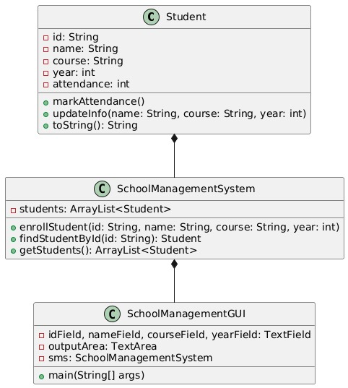
Proposed Architecture

Slide 6
Java Programming - Concepts Used
User Management
Student Information Management
Staff Management
Attendance Management
Fee and Finance Management
Academic Management
Library Management

Slide 7
List of Modules
Student Management Module
Attendance Management Module
Course Management Module
Reporting and Analytics Module
User Management Module

Slide 8
Module Description
Student Management Module: Handles student enrolment, updates, and record-keeping. Stores details like student ID, name, course, year, and personal information.
Attendance Management Module: Tracks and records attendance for each student.Provides options to view individual or overall attendance details.
Course Management Module: Manages courses and their association with students and faculty. Allows updating of course details and linking to academic years.

Slide 9
Module Description (Cont..)
Reporting and Analytics Module:Generates reports on attendance, student details, and overall system usage. Provides insights for administrative decision-making.
User Management Module:Provides access control for administrators, teachers, and students. Ensures secure data handling and role-specific permissions.

Slide 10
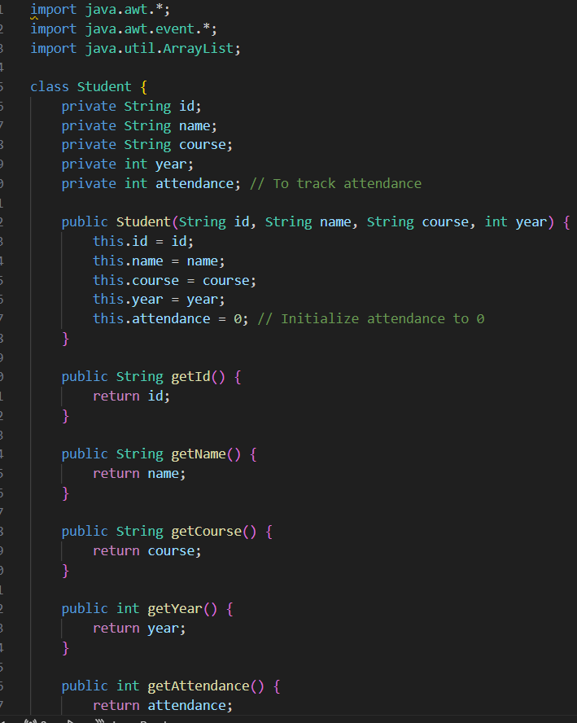
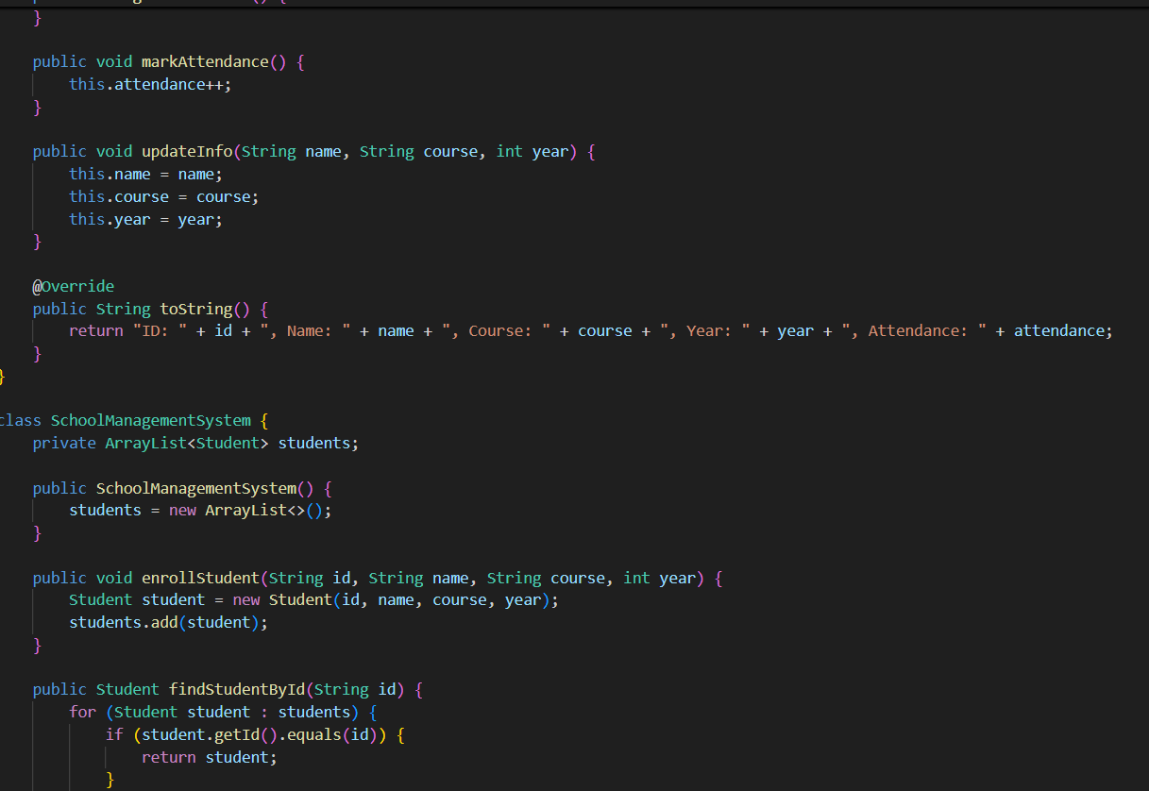
Source Code

Slide 11
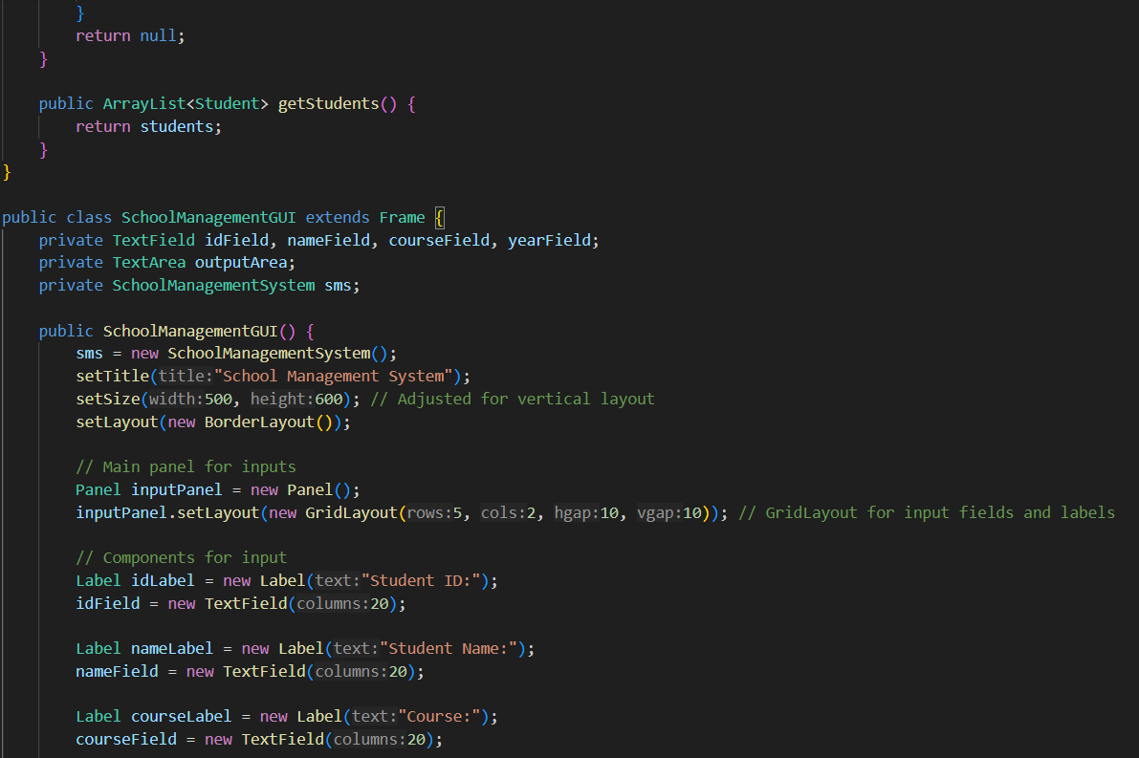
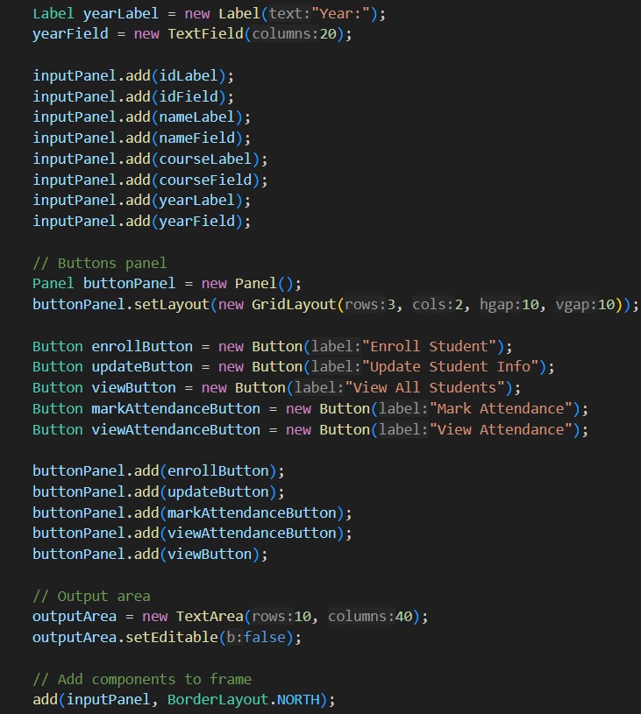
Source Code

Slide 12
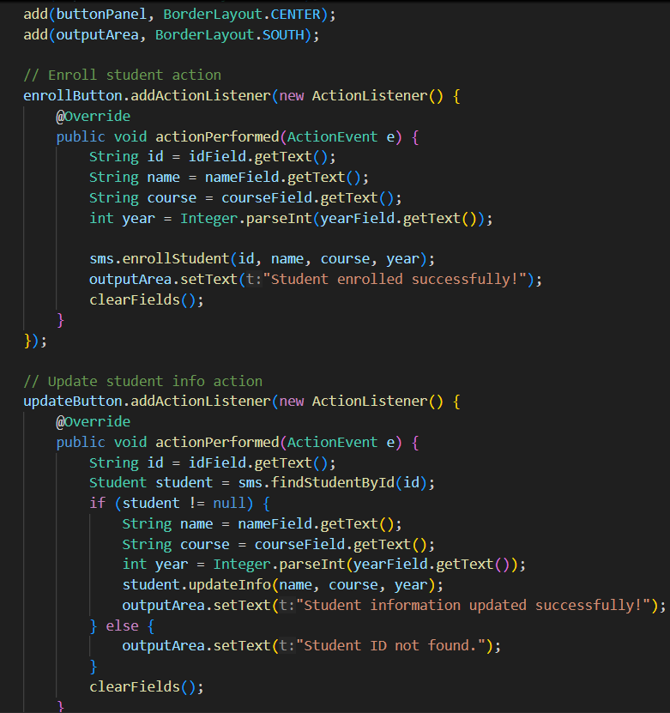
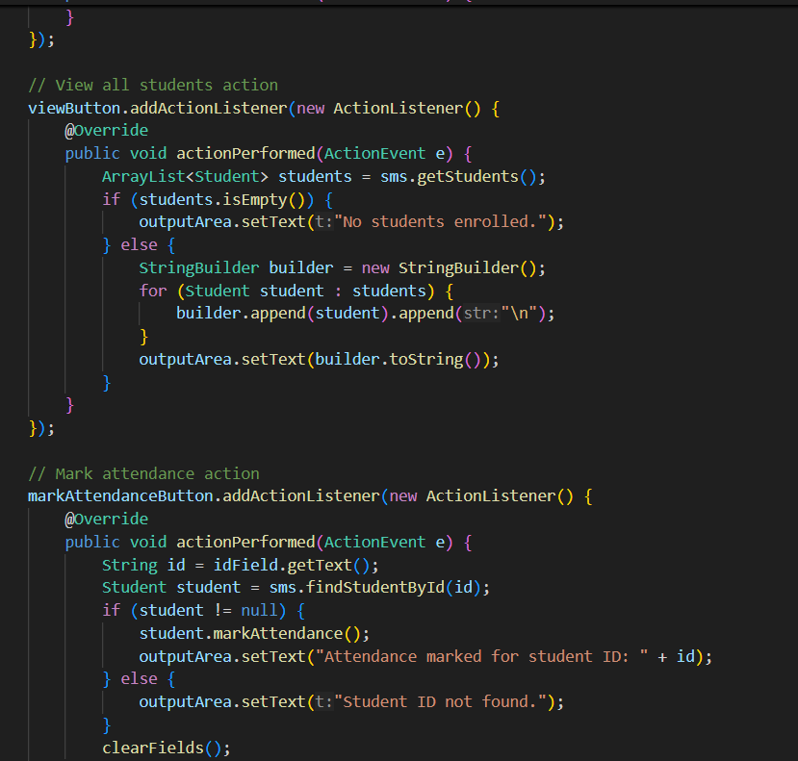
Source Code

Slide 13
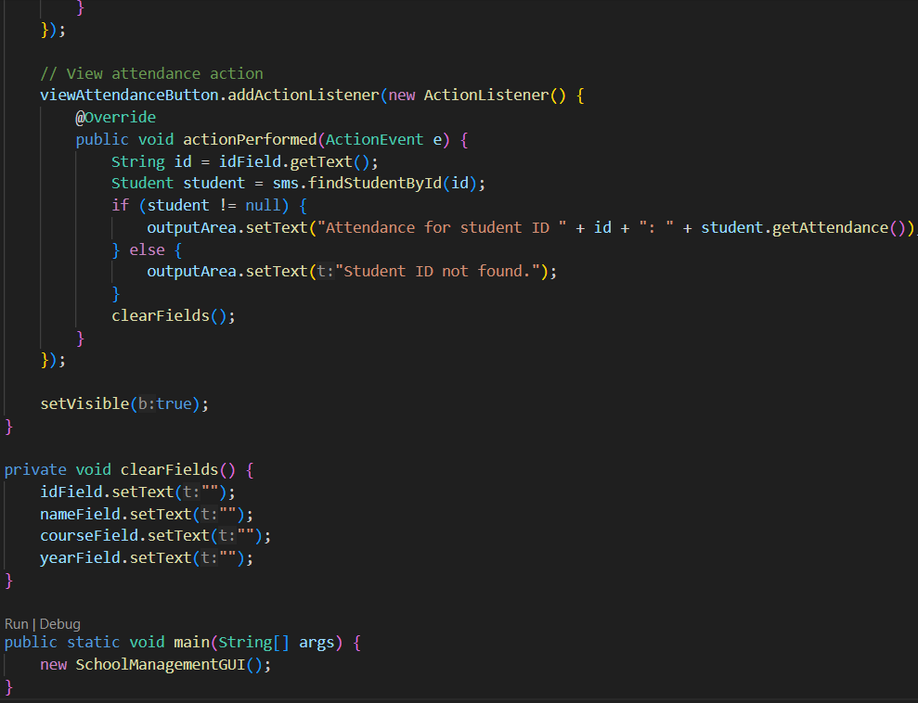
Source Code

Slide 14
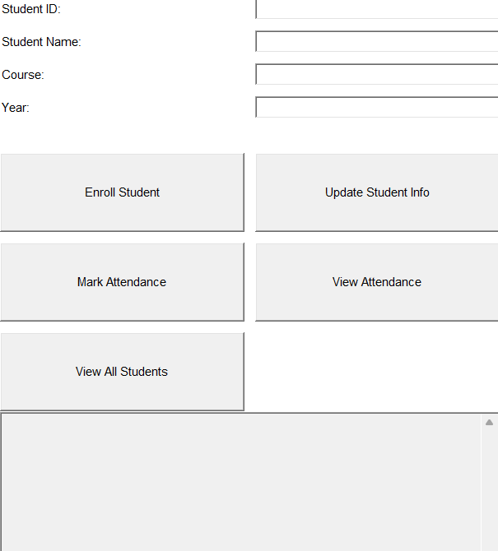
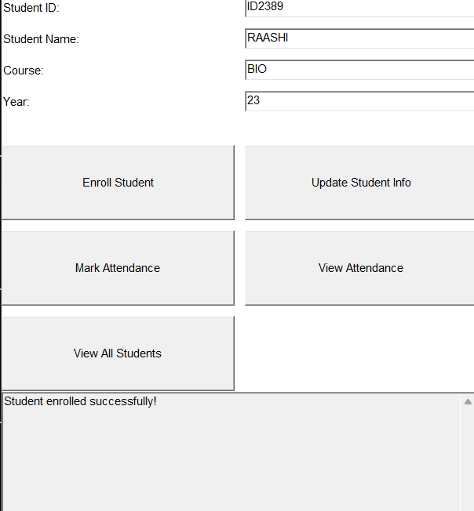
Results
Enroll Student

Slide 15
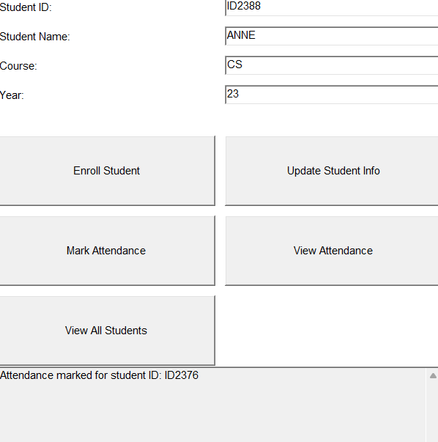
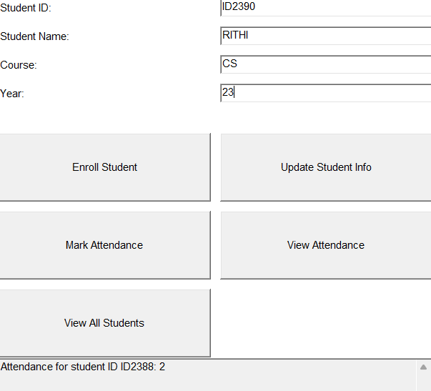
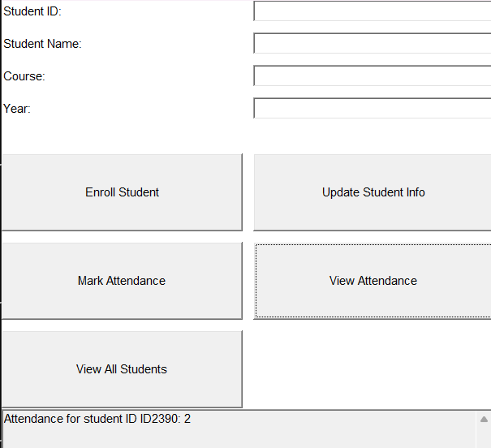
Results
Mark Attendance
View Attendance

Slide 16
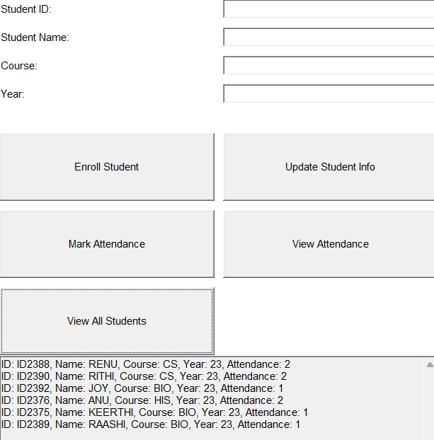
Results
Update and View

Slide 17
Conclusion
The School Management System is a streamlined application designed to efficiently manage student enrollment, update records, and track attendance. With its user-friendly interface, it simplifies administrative tasks by allowing quick access to student data and providing features like attendance marking and information retrieval. The system ensures organized data handling and serves as a foundational tool for digitizing school management processes.

Slide 18
Thank You
Any queries???

